Slide 1
Quick Ingest & Exploratory Data Analysis
The Foundation for Machine Learning on ATTEST Logs

Slide 2
Objective:
=> To build an end-to-end pipeline that converts raw ATTEST logs into machine-readable datasets for analytics and ML tasks. => To perform data ingestion, cleaning, and standardization of log files for consistency and structure. => To conduct exploratory data analysis (EDA) for understanding test volume, failure trends, and data quality. => To engineer key features such as DUT details, execution duration, failure frequency, and environment metadata. => To apply NLP-based techniques (BERT embeddings) to identify semantic similarity in failure messages. => To perform K-Means clustering to group similar failures and detect recurring failure signatures. => To analyze correlations between failure clusters and DUT/config/test conditions, revealing systemic issues and root causes.

Slide 3
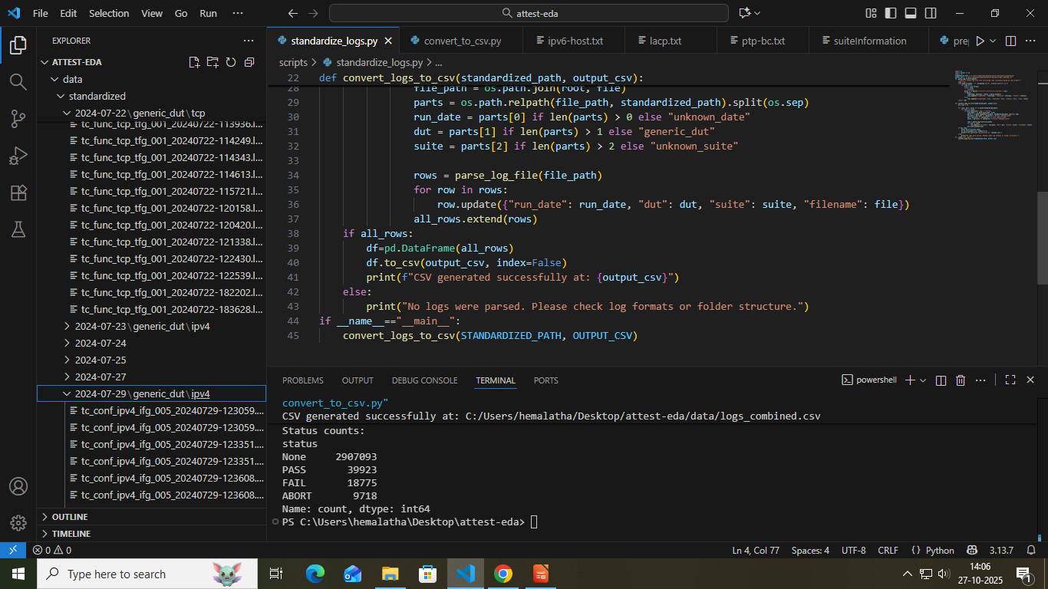
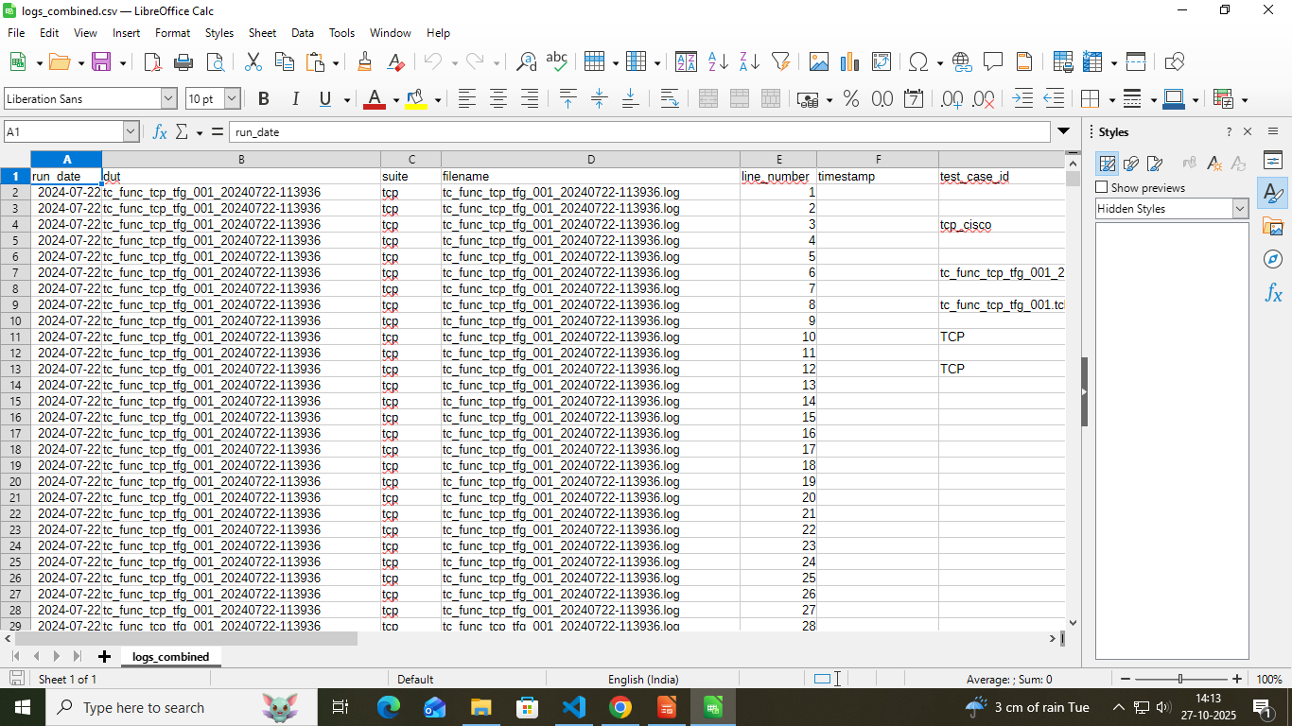
Data Ingestion:
Step 1: Log Extraction (extract_logs.py) : => Used the script extract_logs.py to open .tar.gz archives. => Automatically detects test run_date and suite_name from filenames. => Extracts all log files into a structured folder hierarchy. Output: data/standardize/<run_date>/<suite_name>/
Step 2: Standardize Logs => Used standardize_logs.pyto parse logs and convert them into a consistent format. => Extracted columns: timestamp, testcase, status, run_date, dut, suite, and filename. => Saved standardized output as logs_combined.csv for later analysis.

Slide 4
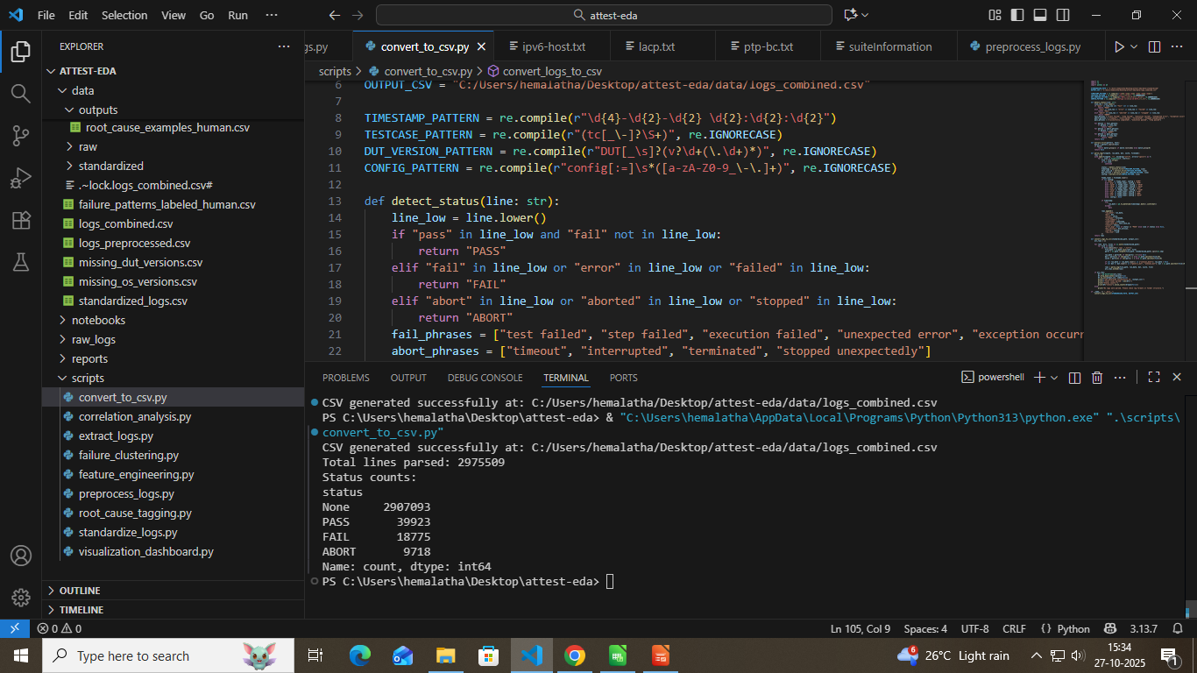
Data Preprocessing:
To transform standardized log files into a clean, structured, and machine-learning-ready dataset by converting, parsing, and cleaning ATTEST test logs
Step 1 – Log Conversion (convert_to_csv.py) => Convert all .log / .txt files from the standardized folder into a single combined CSV dataset. => Extracted structured fields using Regex: Timestamp → YYYY-MM-DD HH:MM:SS Test Case ID → e.g., tc_conf_udp_hvg_002 DUT Version → e.g., DUT v1.0 Config Type → PTP, IPv4, SIP, etc. Status → PASS, FAIL, ABORT => Implemented logic-based status detection using keywords like “pass,” “fail,” and “abort” for accurate classification => Ensured data quality by removing duplicates, handling missing values, and standardized formats. => Combined all logs → logs_combined.csv

Slide 5
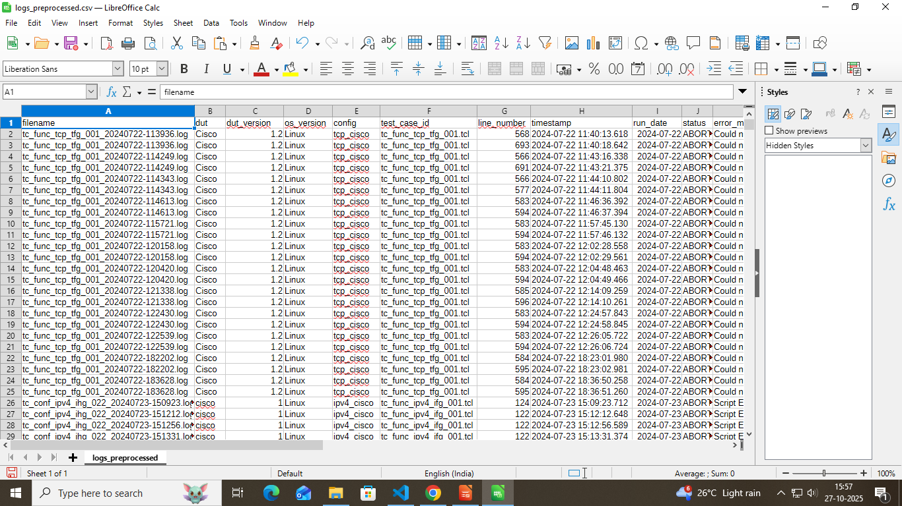
Log Cleaning & Enrichment
Refine raw logs, recover missing details, and create a clean dataset for feature extraction & ML analysis.
=> Extracted header details → DUT Name, Version, OS, Config, Test Case ID using Regex.
=> Parsed line-level info → Timestamp, Status (PASS/FAIL/ABORT), Error Message.
=> Auto-detected suite names (PTP, DTMF, LACP, etc.) and run_date.
=> Filled missing values (timestamps, suites, run_date) using fillna technique & added “No Error” in error_msg column for PASS logs.
=> Recovered context-based error details (±10 lines).
=> Removed duplicates and standardized formats (timestamp, status, config, suite).

Slide 6
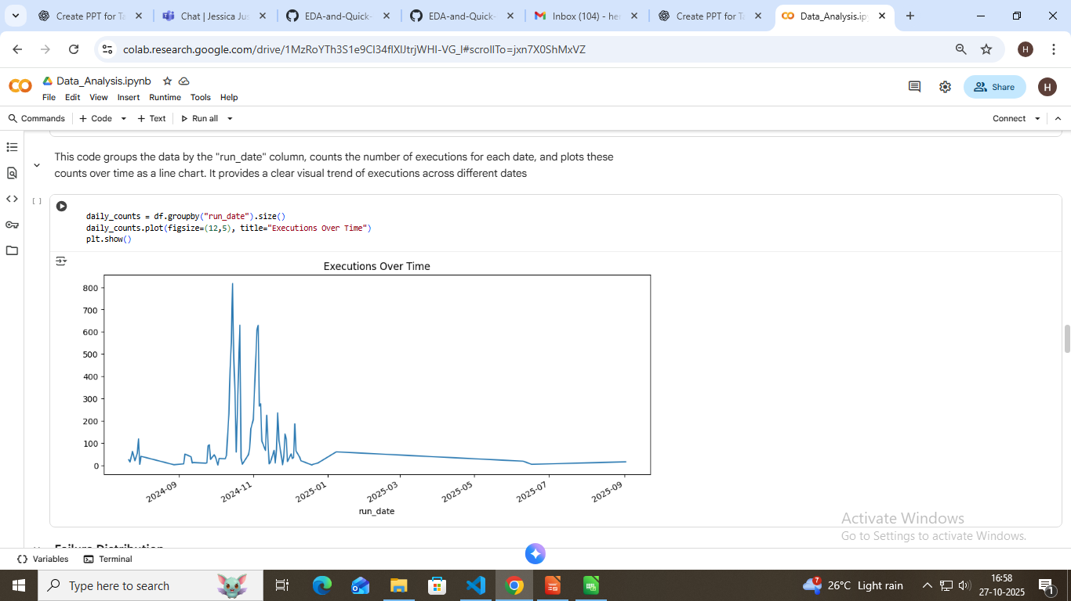
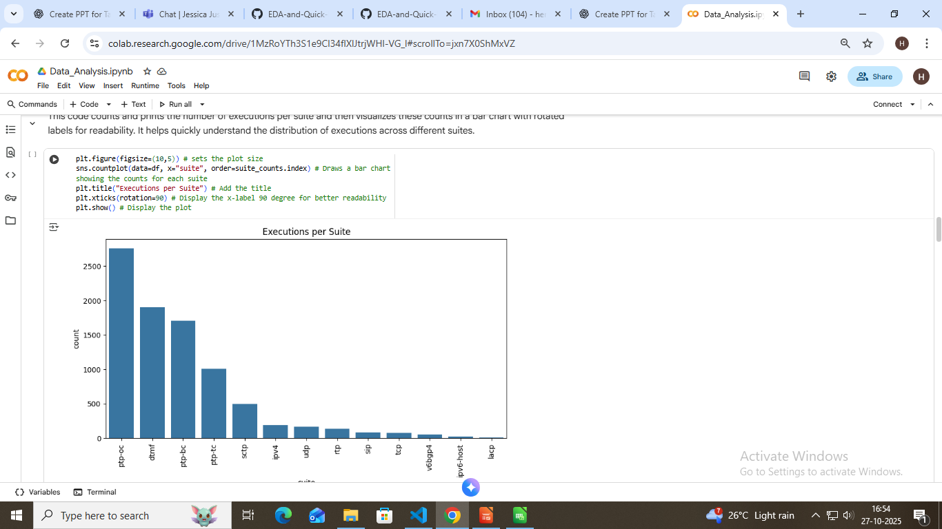
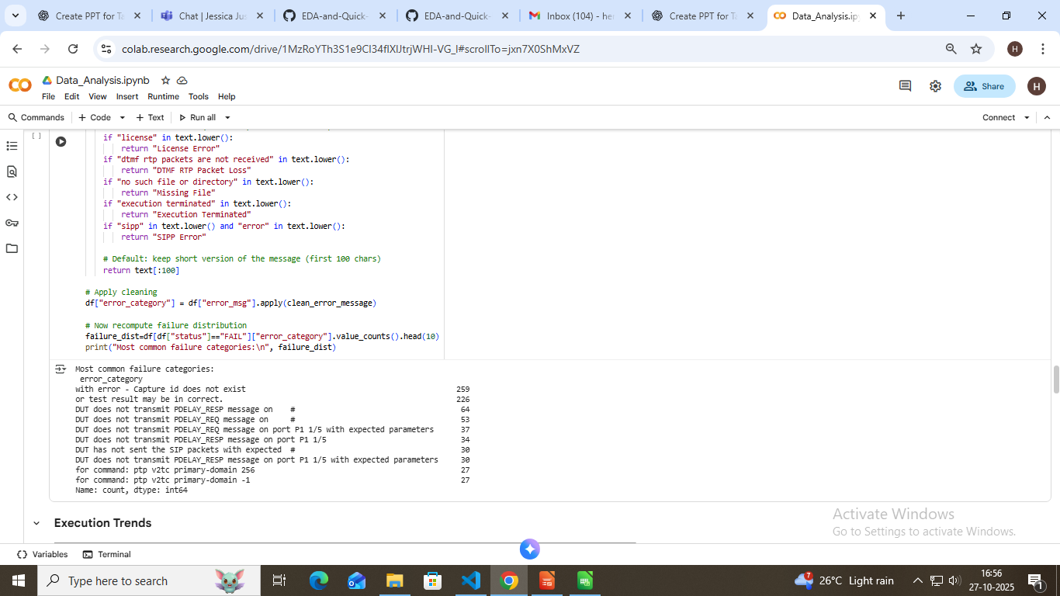
Exploratory Data Analysis (EDA):
To uncover patterns, trends, and anomalies within the preprocessed test log data — helping identify key failure behaviour and areas for improvement.
Volume Analysis: =>Aggregated total test executions by suite, DUT, and run date. =>Used Pandas groupby and count functions to measure data coverage.
Failure Distribution: => Classified logs by status (PASS, FAIL, ABORT). => Identified most frequent failure messages and recurring error categories.

Slide 7
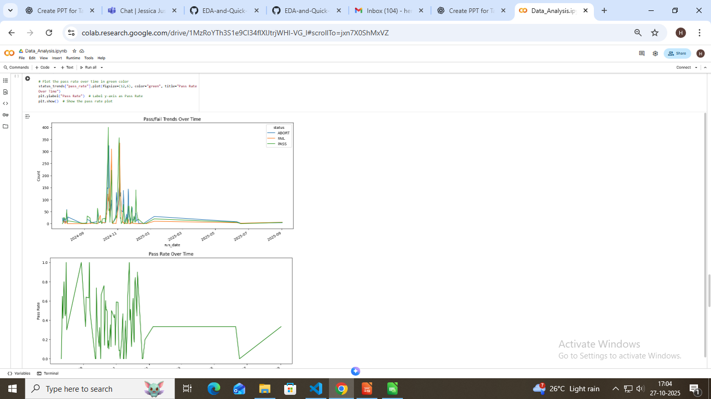
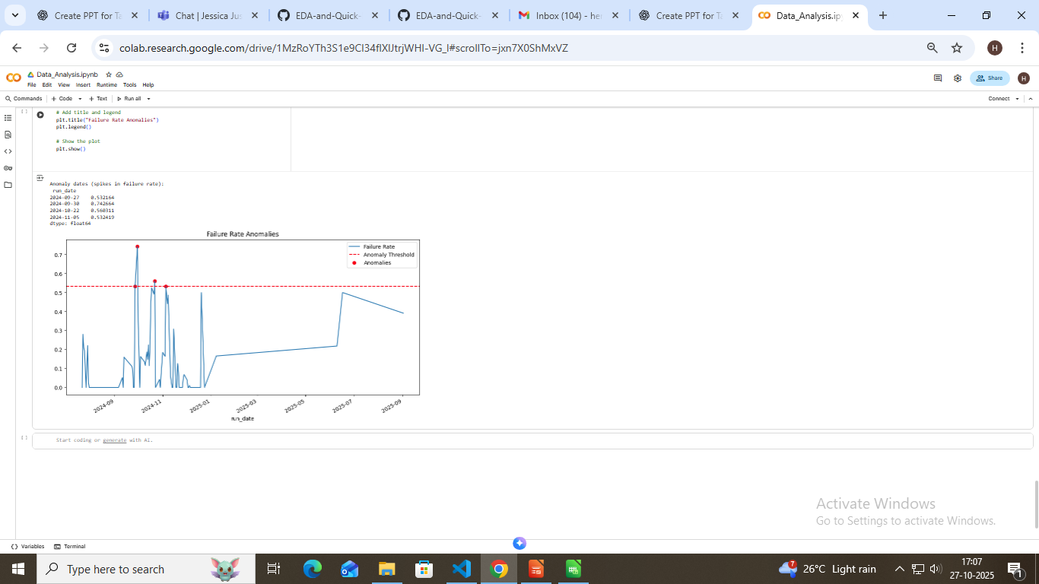
Execution Trends: => Visualized pass/fail rate over time to monitor stability and reliability. => Line charts plotted using Matplotlib/Seaborn.
Anomaly Detection:
=> Detected sudden spikes in failure rate or abnormal DUT behavior. =>Highlighted runs deviating from average trend for deeper inspection.

Slide 8
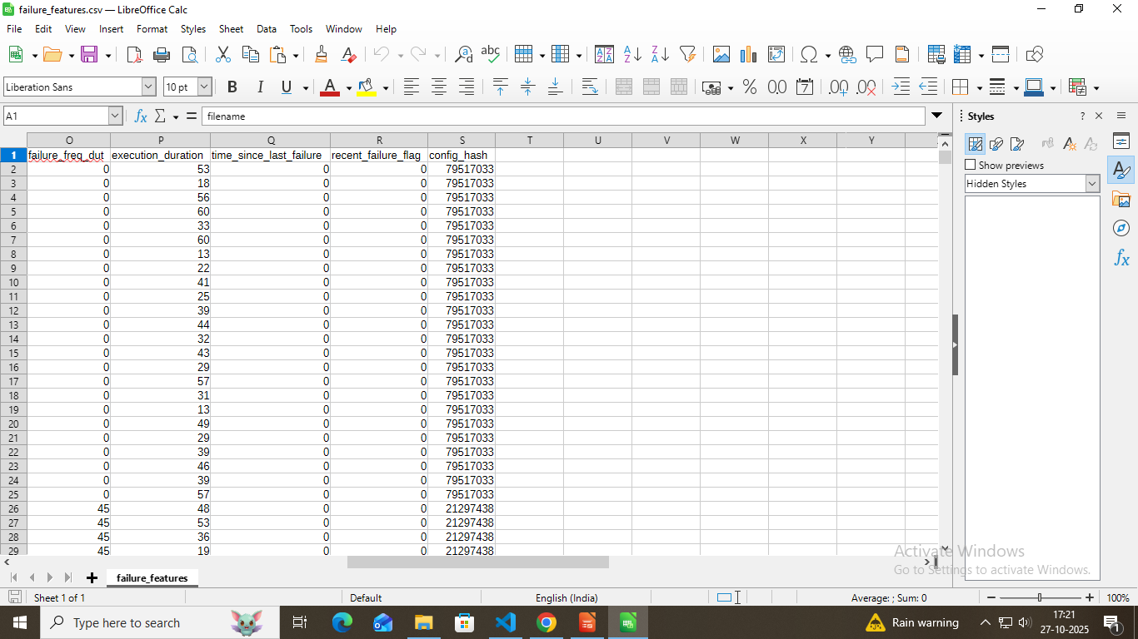
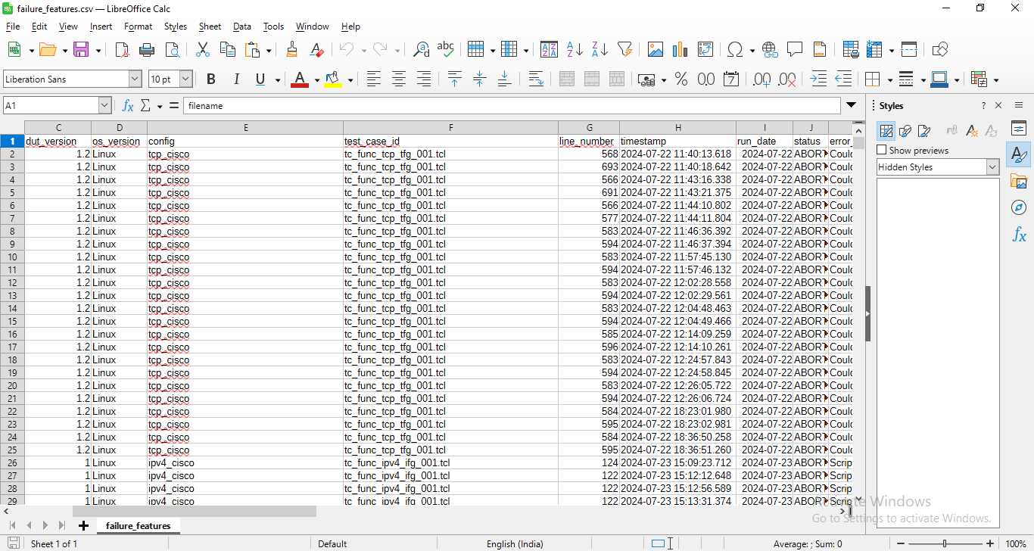
Feature Engineering:
=> Loaded cleaned dataset logs_preprocessed.csv. => Normalized key fields (status, timestamp, etc.). => Filtered only valid test outcomes → PASS, FAIL, ABORT. => Calculated failure frequency by suite and DUT. => Generated execution_duration for each test run. => Computed time_since_last_failure per DUT & Test Case. => Added recent_failure_flag (1 for FAIL, 0 otherwise). => Encoded configuration info as numeric config_hash. => Replaced missing or PASS log errors with “No Error”. =>Saved output to → data/features/failure_features.csv.

Slide 9
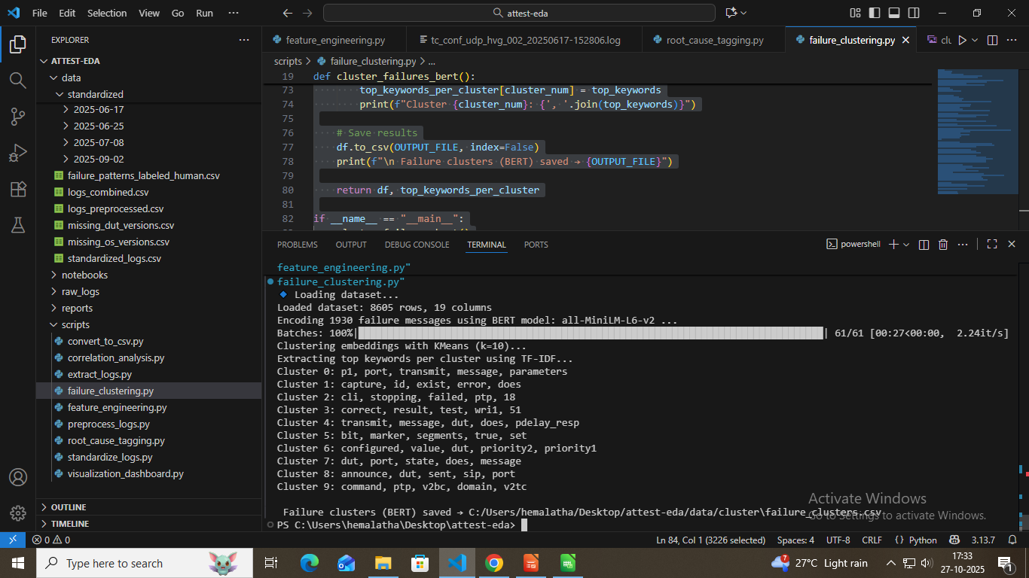
NLP Embedding using BERT
Convert log error messages into meaningful numerical representations to capture semantic similarity. Clean and normalize error messages from standardized logs.
=> Loaded failure_features.csv and filtered only FAIL logs. => Cleaned and standardized error messages. => Converted text messages into semantic embeddings using BERT (all-MiniLM-L6-v2). => Applied KMeans clustering (k=10) to group similar failure types. =>Extracted top 5 keywords per cluster using TF-IDF vectorization for interpretability. => Assigned cluster labels back to dataset for analysis. =>Saved final output to: data/cluster/failure_clusters.csv

Slide 10

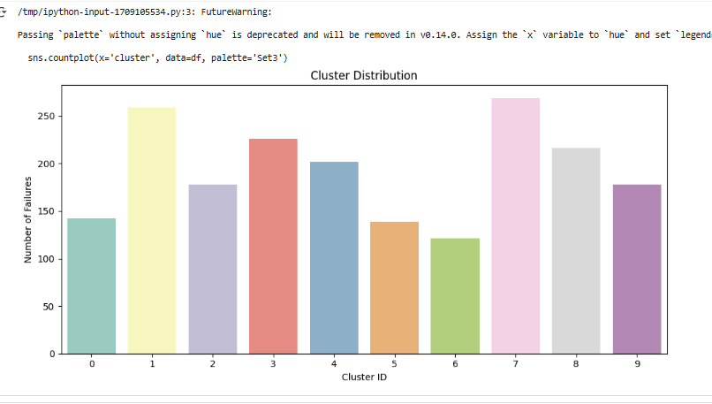
K-Means Clustering:
To group semantically similar failure logs into clusters for identifying common failure patterns.
=> Used BERT embeddings of error messages as feature vectors. => Applied KMeans clustering (k = 10) to group similar failures. => Each cluster represents a unique failure signature or pattern. => Extracted top keywords from each cluster using TF-IDF for interpretability. => Assigned cluster labels to each log entry. => Saved clustered results to: data/cluster/failure_clusters.csv

Slide 11
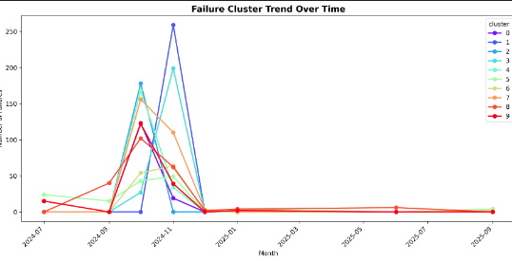
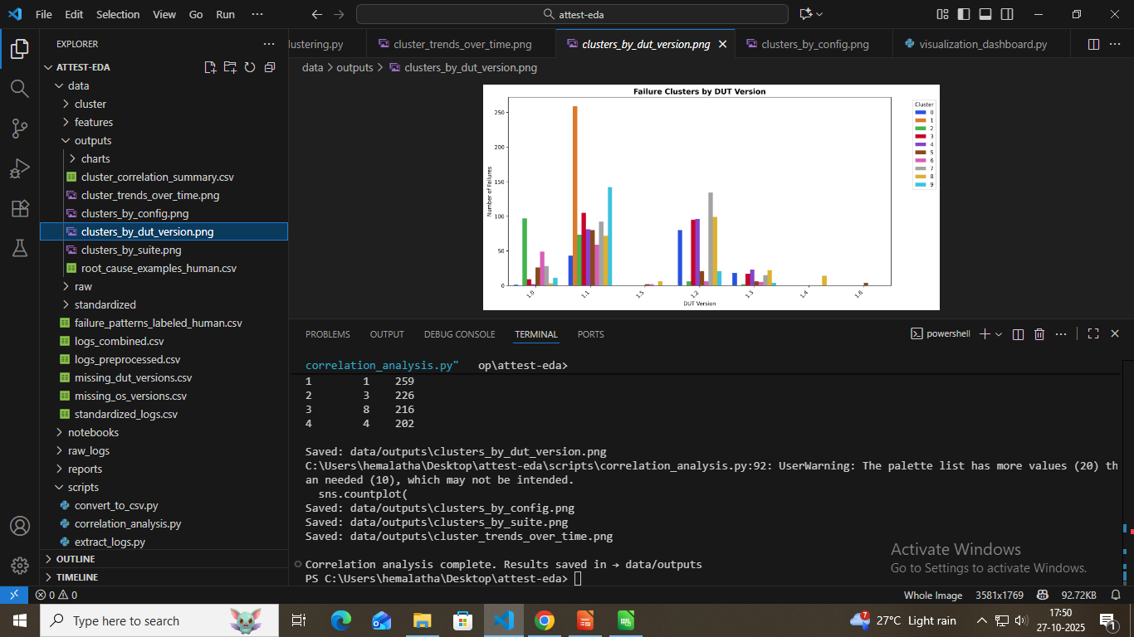
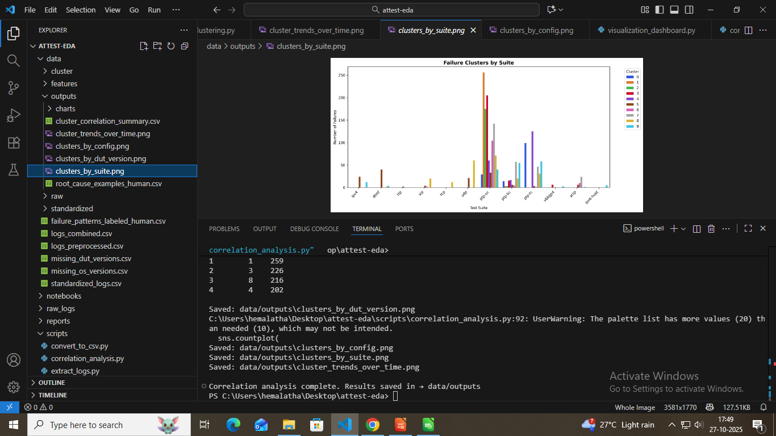
Pattern Detection & Correlation Analysis:
To uncover hidden relationships between failure patterns (clusters) and system attributes such as DUT version, configuration, and time.
=> Loaded failure_clusters.csv generated from KMeans–BERT clustering. => Verified presence of key columns: cluster, dut_version, config, suite, run_date. => Filtered only valid cluster labels (≥ 0). => Calculated failure frequency per cluster for summary insights. => Used Seaborn visualizations to correlate clusters with: DUT versions → Identify version-specific issues. Configurations → Detect config-related failures. Suites → Highlight test suite sensitivity. Time (run_date) → Observe trend of recurring issues. =>Saved all correlation plots and summary CSVs to data/outputs/

Slide 12
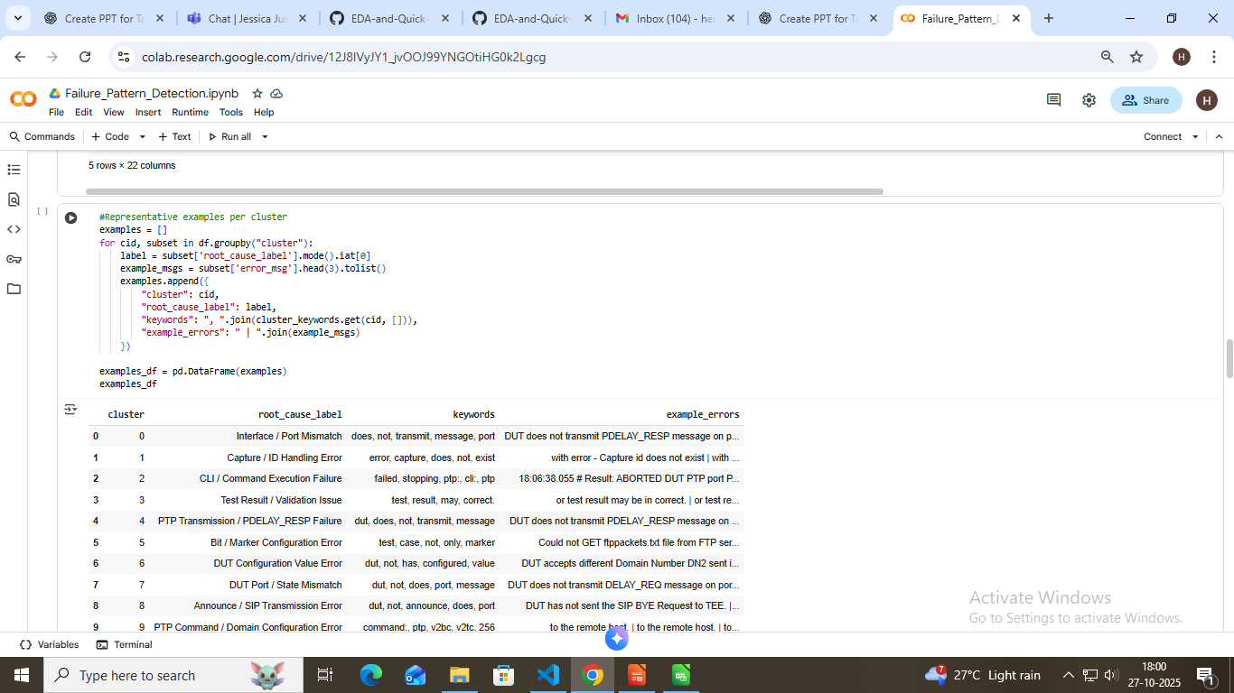
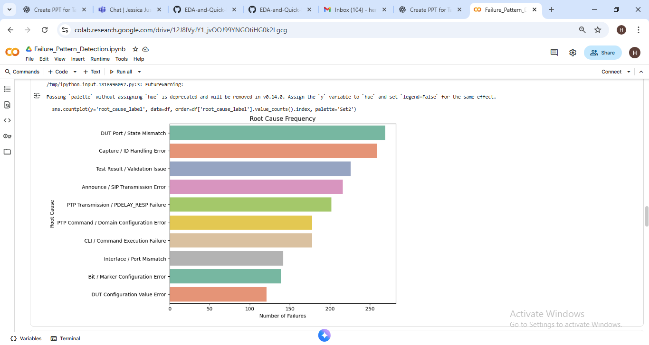
Root Cause Pattern Labelling
=> Loaded failure_clusters.csv from clustering output. => Filtered valid clusters (cluster != -1) and handled missing messages. => Extracted frequent keywords per cluster using Counter() (ignoring stop words). =>Defined manual mappings (HUMAN_LABELS) for 10 key root cause categories: Interface/Port Mismatch Capture ID Handling Error CLI Command Failure Validation Issues PTP Transmission Errors DUT Configuration Issues, etc. => Mapped clusters → human-readable root cause labels. =>Selected sample failure messages (3 per cluster) as representative examples.

Slide 13
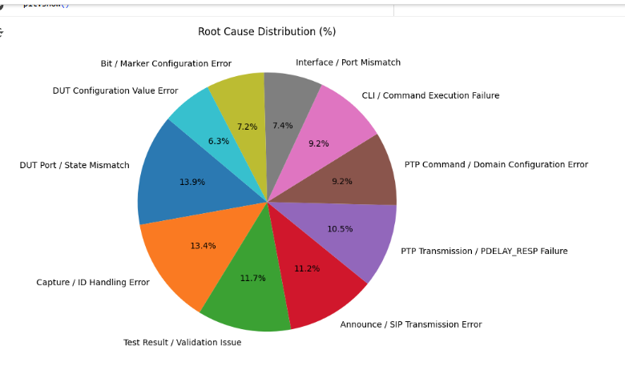
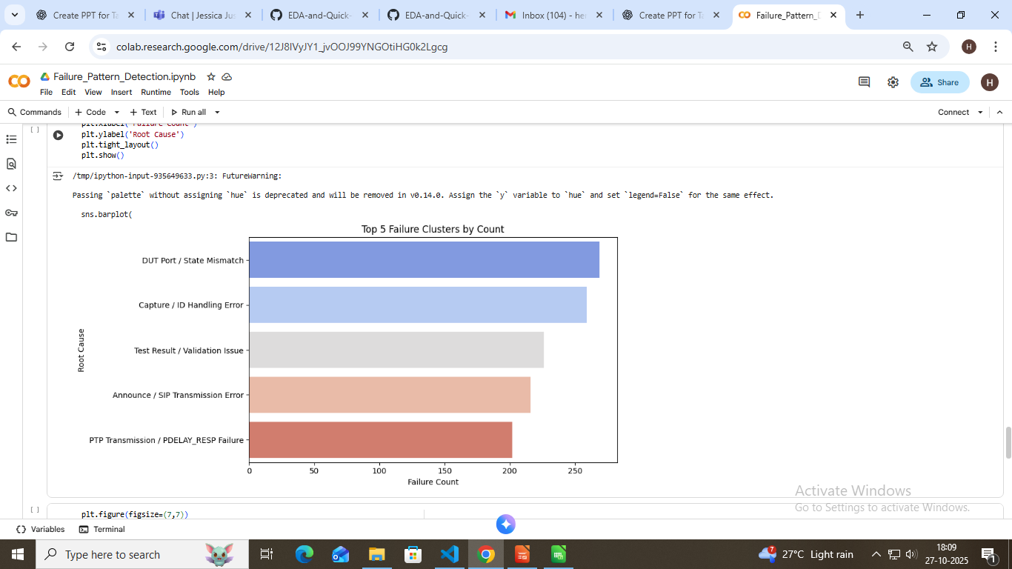
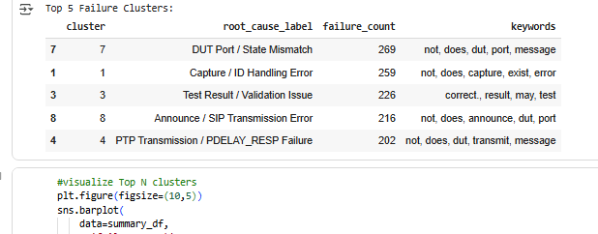
Visualization & Reporting
=> Loaded the labelled dataset containing clusters and root cause categories. => Visualized Root Cause Frequency to identify the most recurring failure patterns. => Plotted Cluster Distribution to understand how test failures are grouped. => Extracted and summarized Top Keywords for each root cause to interpret cluster meanings.

Slide 14
Thank You

